Slide 1
Spark project
Yeruult
Pavan
Erdembayar

Slide 2
Spark streaming
Scalable, high-throughput, fault-tolerant stream processing of live data streams
I implemented 2 types and 4 implementation in Jav 1.8
WordCount from Network Streaming
  JavaNetworkWordCount = Spark Streaming + Hbase
  It streams user input from other side and calculate count of each words.
  Then save (word,count) in Hbase for further processing.
  JavaStatefulNetworkWordCount = Spark STREAming + Statefull
  Previous implementation doesn’t keep track of already received words. But with introduction of ‘checkpoints’ we can keep keep track of (word,count) values.
Streaming from Twitter
  StreamingTweetsSimple = Spark Streaming, hashtag counts.
  We follow ‘#Money’ topic and check with hashtag’s are connected for now.
  TweetStream = Spark Streaming, latest twitter trends.
  We check what is hot latest trends on Twitter.

Slide 3
Java 1.8
I tried both Scala and Java 1.8 and each of them had mixed result.
Scala
  Pros
    There are many tutorials and guides for Scala on internet
    Works without much hassle after configure
  Cons
    Very slow on Eclipse
    Many dependencies doesn’t work.
    Many unkwon terms
https://www.youtube.com/watch?v=Yb590NwDDi8
http://bigdatafan.blogspot.com/2016/05/upgrade-java-to-jdk-8-on-cloudera-cdh.html

Slide 4
Java 1.8
  Pros
    Very fast on Eclipse compare to Scala
    Programming is not difficult
    Works in Eclipse
  Cons
    Some version of Maven dependencies doesn’t exist
    Exported jar file doesn’t work terminal

Slide 5
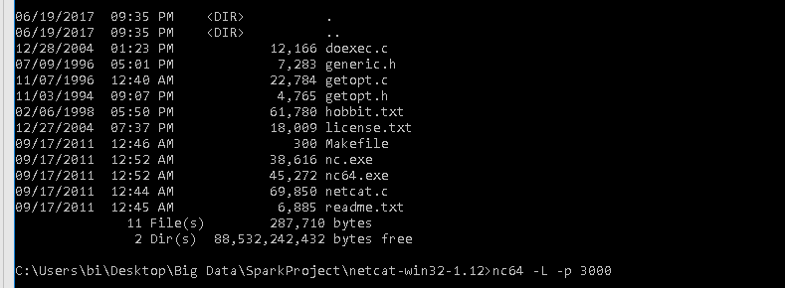
Word count streaming
JavaNetworkWordCount = Spark STREAming + hbase
Netcat
NetCAT: popular network connection tool. (For switch I use ‘L’ for continued connection. Port: 3000
It’s built in Linux/Cloudera and we can download it for Windows.

Slide 6
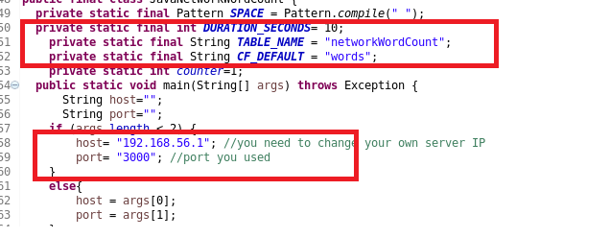
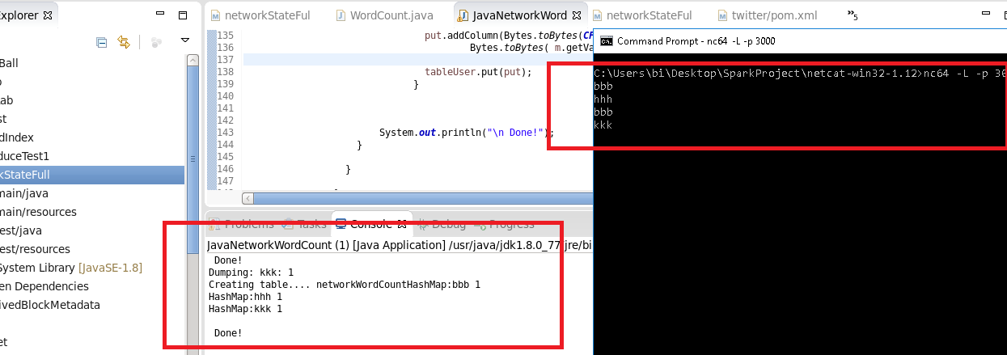
Duration: 10 seconds.
We save our data in Hbase table:
‘netWorkCount'
host: My Windows computer IP
port: 3000

Slide 7
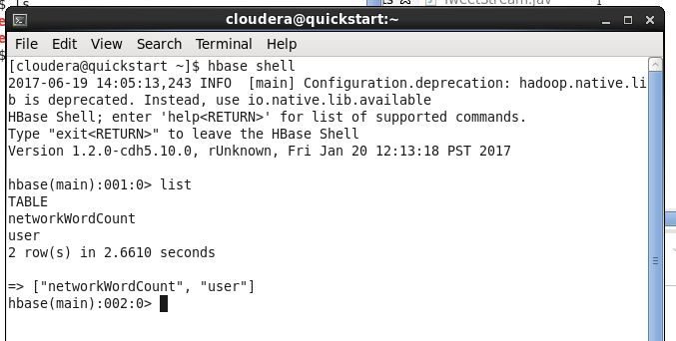
Hbase section:
>>hbase shell
>>list

Slide 8
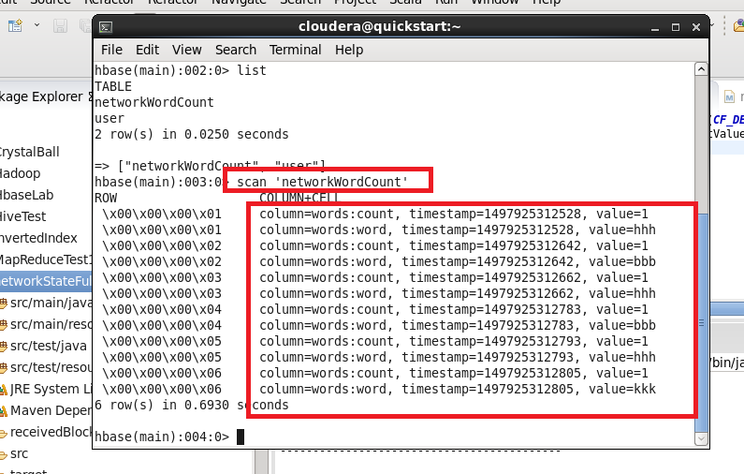
Hbase section:
>>scan ‘networkWordCount’
Here streamed data saved in Hbase

Slide 9
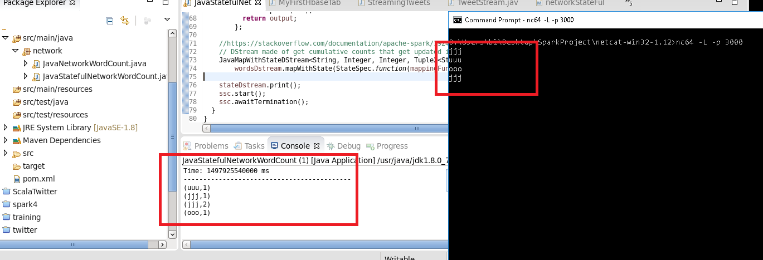
JavaStatefulNetworkWordCount = Spark STREAming + statefull
netcat
After entering 4 words on server.

Slide 10
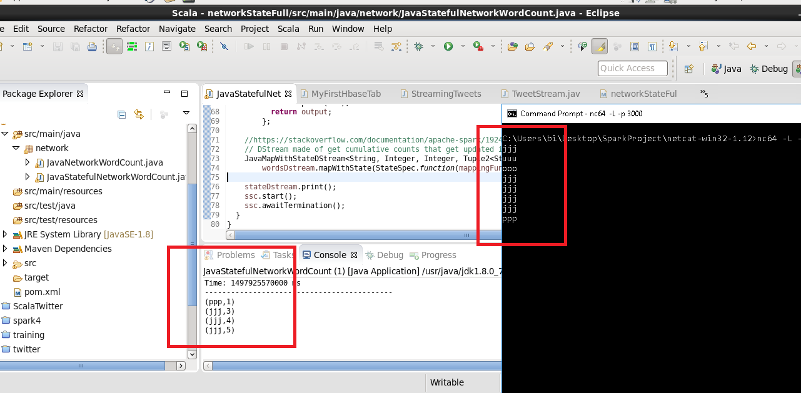
After entering another 4 words on server. Total 8 words.

Slide 11
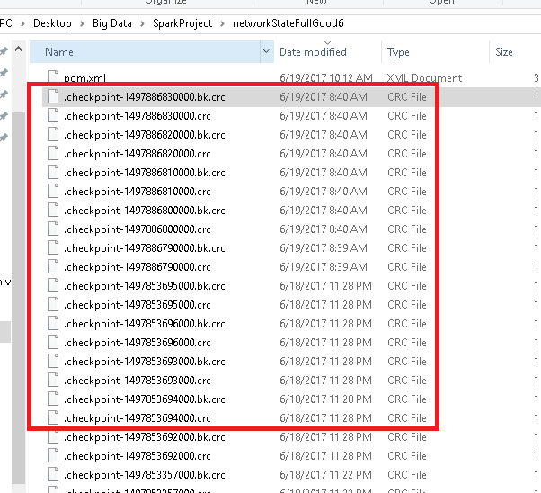
Here is 'checkpoint' data for
'Statefulness' created by spark.
Create checkpoints for storing
previous state

Slide 12
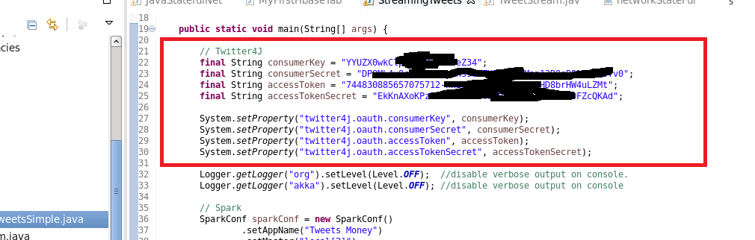
Twitter Streaming
StreamingTweetsSimple = Spark STREAming, hashtag counts
First we need to configure access token and keys from Twitter dev area and fill it here.
Duration: 5 seconds

Slide 13
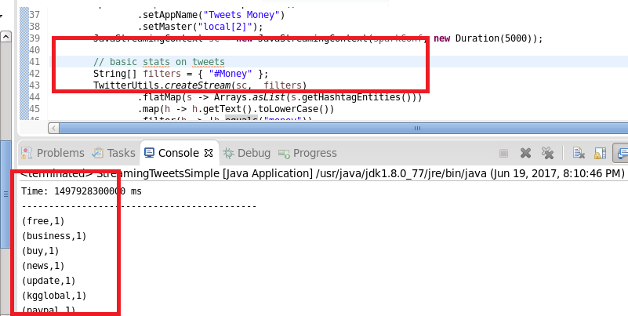
We follow ‘#Money’ tag. Below is related tags in Twitter.
Duration: 5 seconds.

Slide 14
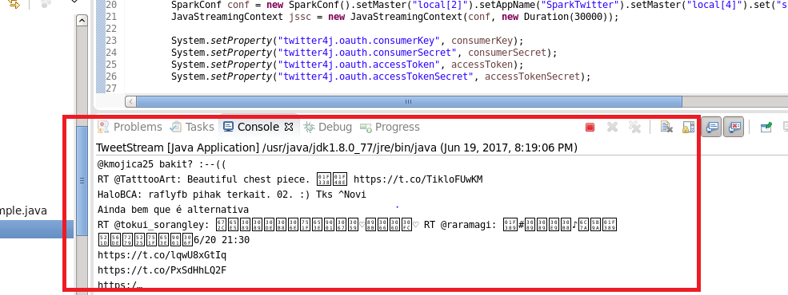
Twitter Streaming
TweetStream = Spark STREAming, latest twitter trends
Duration: 30 seconds

